Slide 1
MLO New Dash Graphs
File created on: 5/18/2021 8:57:20 AM

Slide 2
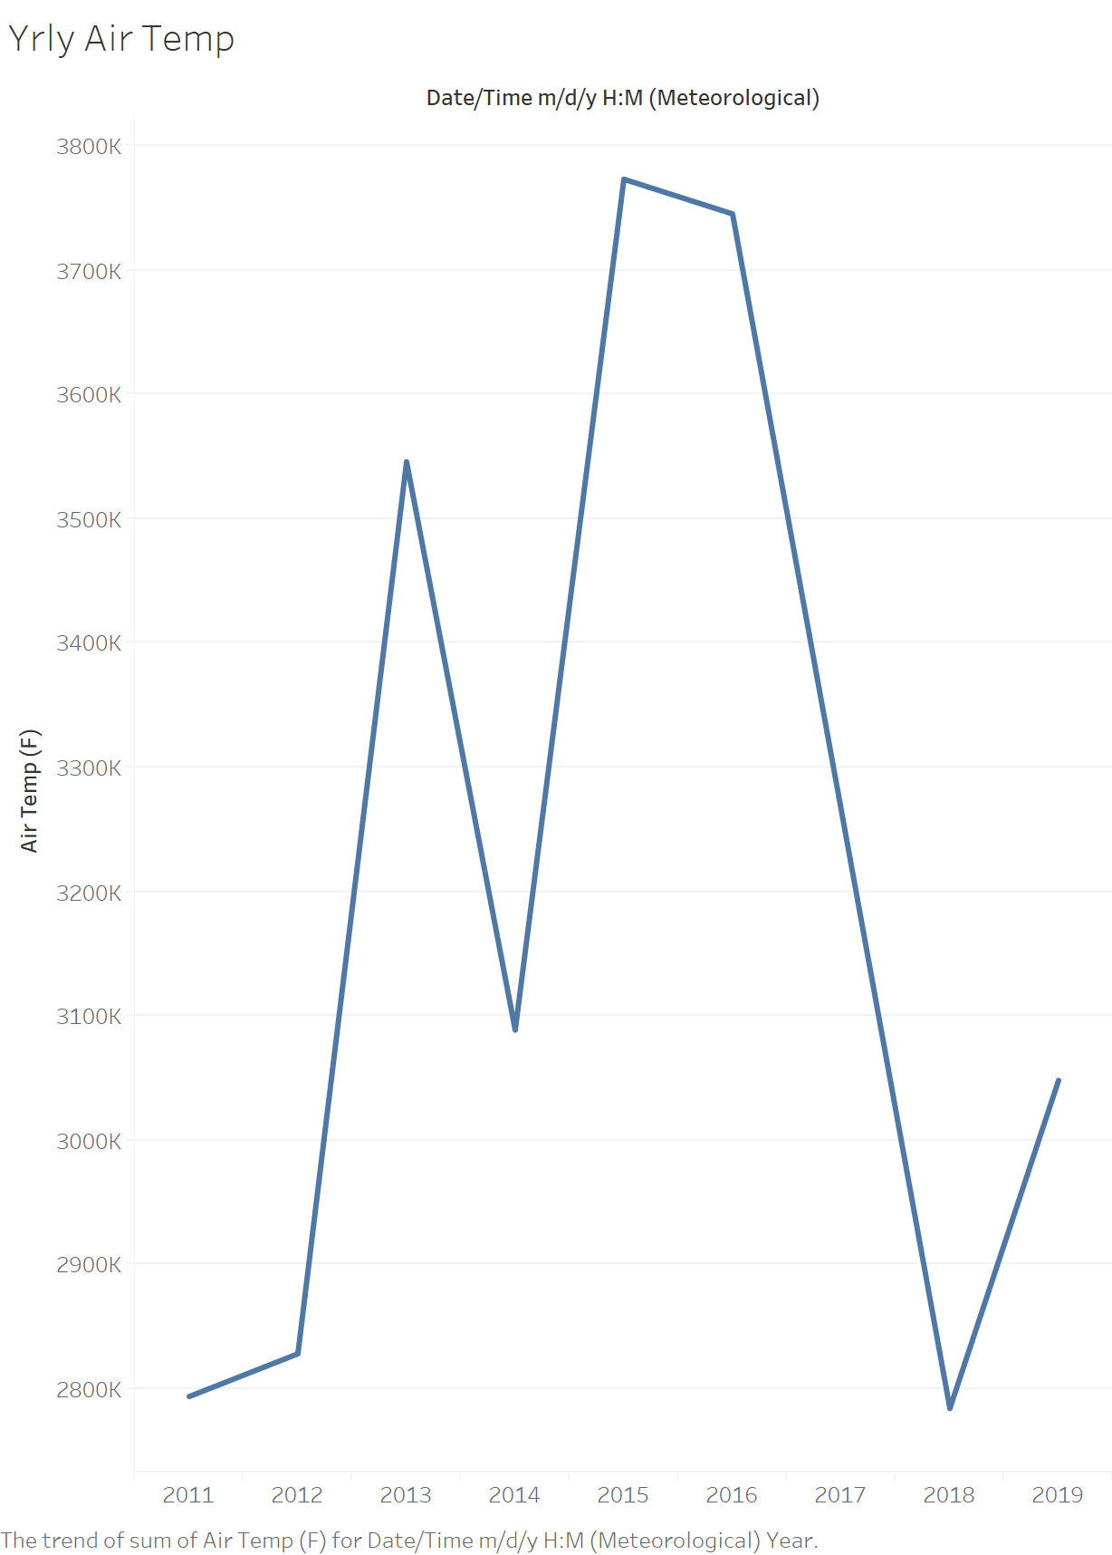

Slide 3
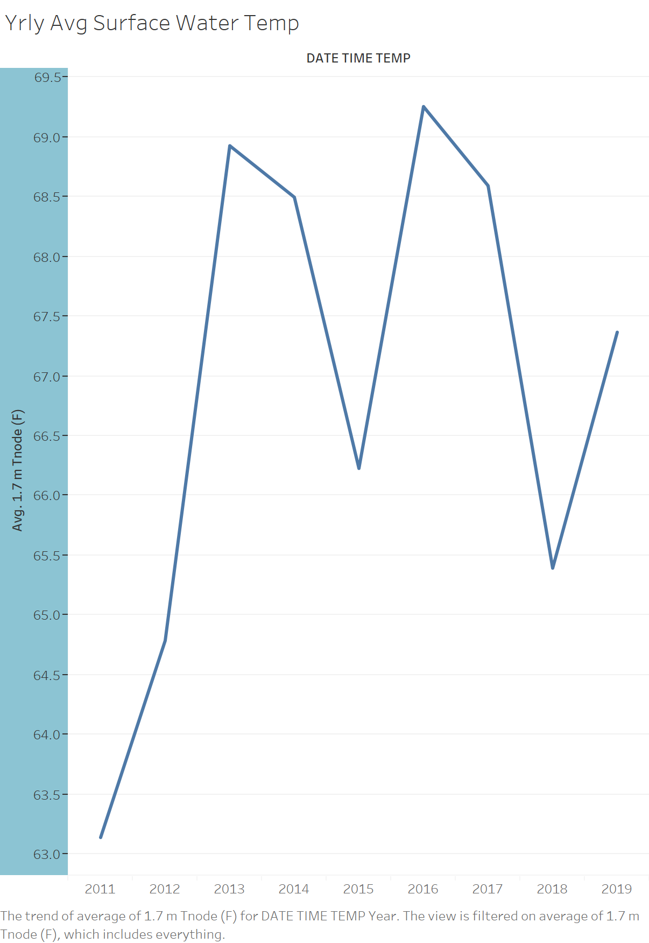

Slide 4
